Slide 1
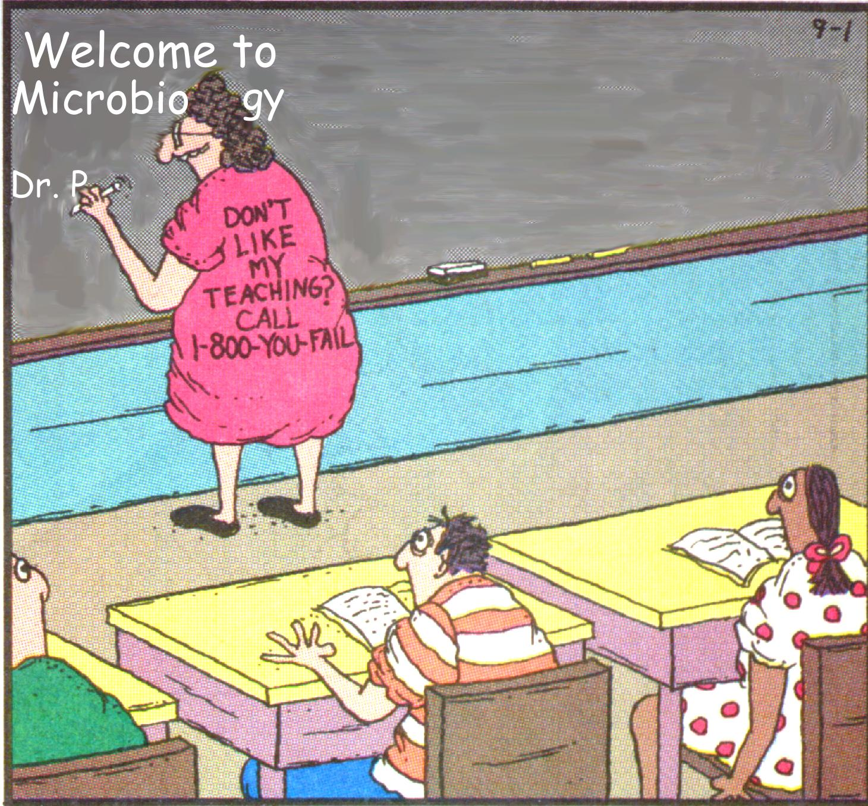

Slide 2

Bacteriology Department of Microbiology 2015 Dr. Ousman Secka

Slide 3
House Rules
No mobile phones
Not a teaching session
Do participate
Ask questions
Be on time

Slide 4
What is SAID is not HEARD
What is HEARD is not UNDERSTOOD
What is UNDERSTOOD is not RETAINED
What is RETAINED is not IMPLEMENTED

Slide 5
Course content
Understand the principles of bacteria and bacterial infection
microbial structure, physiology and genetics;
microbial taxonomy, classification and Identification
host defence mechanisms, the immune system and immunity to infection;
microbial pathogenicity;
epidemiology of infectious diseases - their surveillance and control;
antimicrobial agents, their mode of action and mechanisms of microbial resistance.

Slide 6
Outcome
Not microbiologists
To appreciate and understand
The role of the microbiologist
Role of microbiology in medical practice
How you use microbiology & microbiologist to do your work better

Slide 7
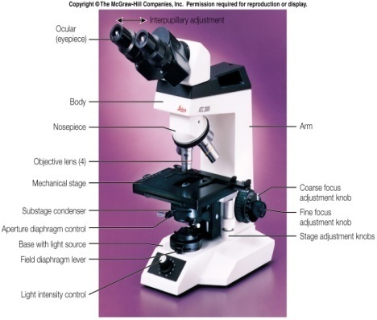
Introduction
What is microbiology?
“microbiology’ - the study of microorganisms
organisms too small to be seen with the naked eye
except in large groups
effects of large numbers often visible
e.g., chemical reactions in soil horizons
e.g., toxin and gas production in incompletely sterilised food cans
e.g., disease in animals and plants

Slide 8

Introduction
organisms too small to be seen with the naked eye
What do you use to see micro-organisms?
Microscope

Slide 9
Microscopes
Different types with different functions
………………..separate topic………

Slide 10
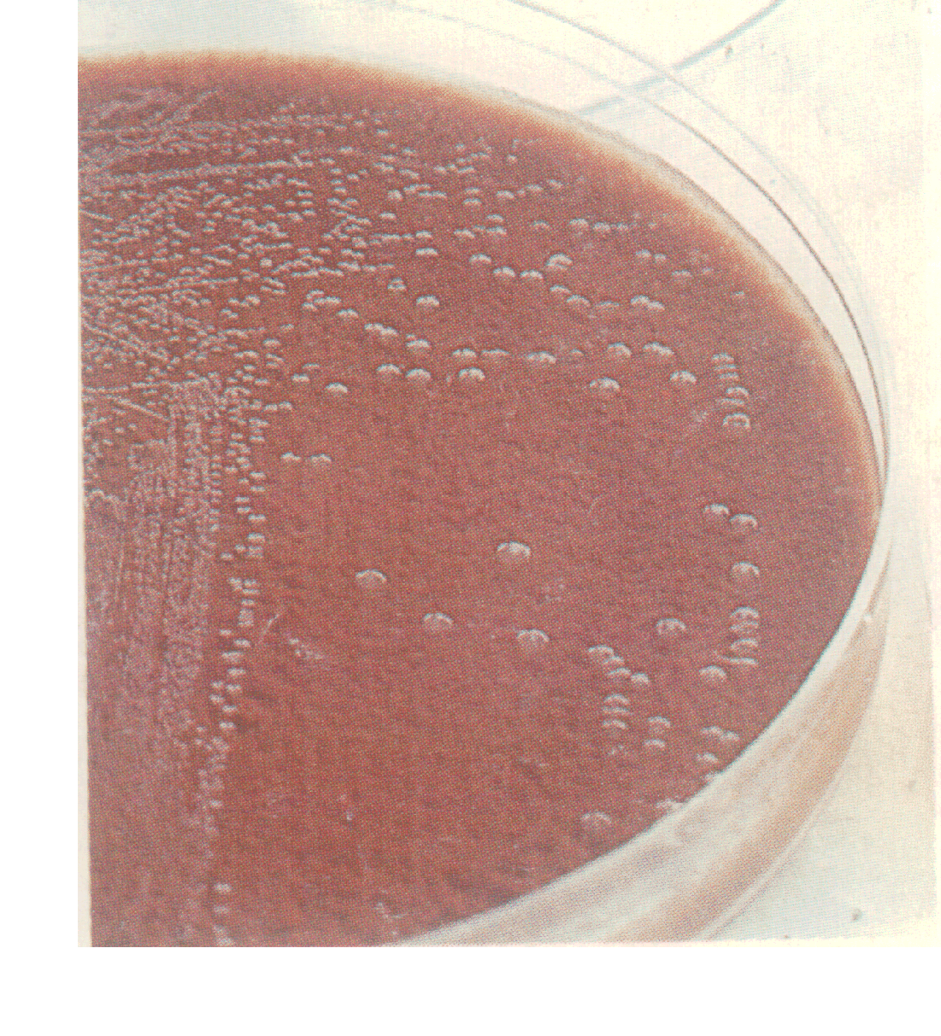
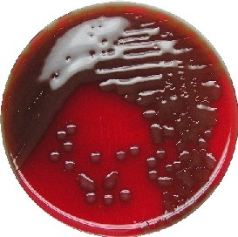
Microbiology – organisms too small to be seen with the naked eye
except in large groups
Streptococcus pneumoniae
Haemophilus influenzae
Colonies of bacteria

Slide 11


organisms too small to be seen with the naked eye
except in large groups
Mould on bread

Slide 12



Effects of large numbers often visible
bad storage cond
Unsterile processing

Slide 13
Branches of study
Branch | Definition
Bacteriology
Mycology
Virology
Parasitology
Study of bacteria
Study of fungi and yeast
Study of viruses
Study of parasitic protozoans and helminths

Slide 14
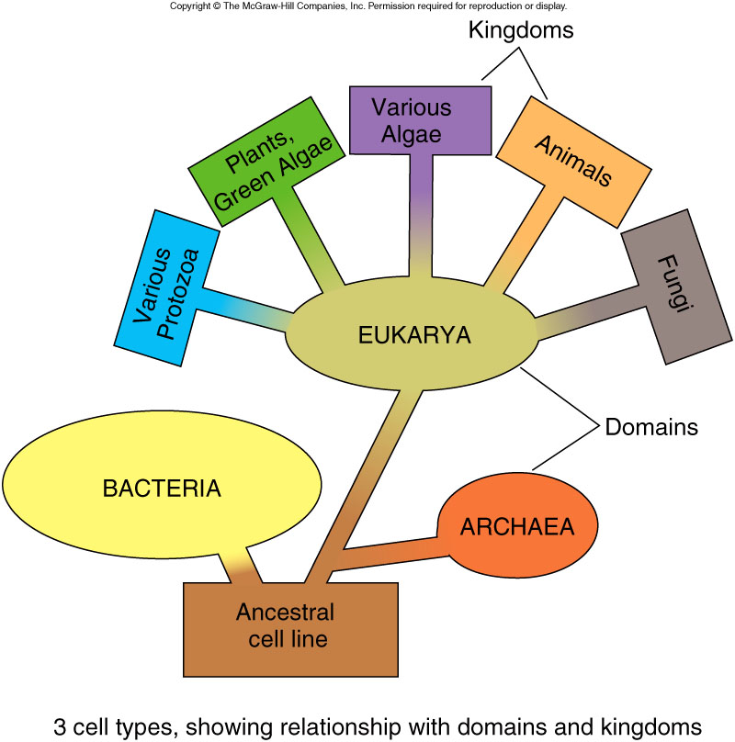
Microbial Taxonomy
3 Domain System

Slide 15
Nomenclature
Linnaeus introduced the binomial system of scientific nomenclature
Each organism has two names: the genus and species epithet
Italicized or underline
Genus name is capitalized and species in lower case.

Slide 16
Scientific names
Staphylococcus aureus
describes clustered arrangement of cells and golden yellow color of colonies
Escherichia coli
Honors the discoverer, Theodor Escherich and describes its habitat, the colon.
After the first use, scientific names may be abbreviated with the first letter of the genus and full species epithet. (Ex: E. coli)

Slide 17
General characteristics
Cell type | Definition
Prokaryotes
Eukaryotes
Acellular agents
no nucleus and organelles
membrane bound nucleus and organelles
genomes contain either DNA or RNA; newer agent is proteinaceous

Slide 18
Microbial World?
What is the microbial world consists of?
Viruses
Bacteria
Fungi (Yeasts and Molds)
Protozoa
Microscopic Algae

Slide 19
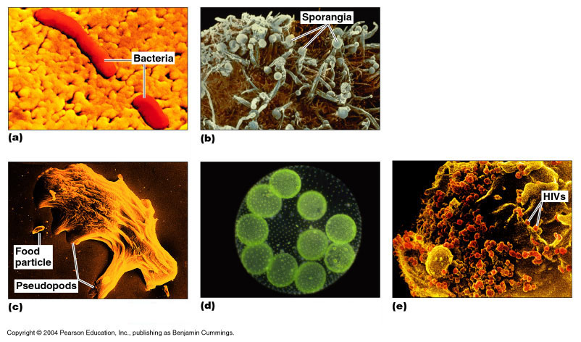
Bacteria
Prokaryotes
Peptidoglycan cell walls
Binary fission
Ex: Escherichia coli

Slide 20
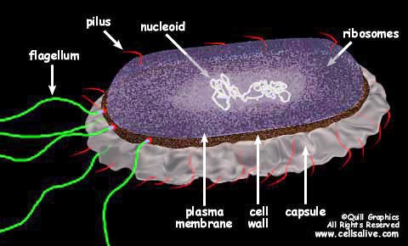
Definitions of organisms
Bacteria-
Unicellular,
Prokaryotic
The nucleus is not organised
Circular double stranded DNA lies loose in the cytoplasm
Rigid peptidoglycan cell wall
divide by binary fission

Slide 21
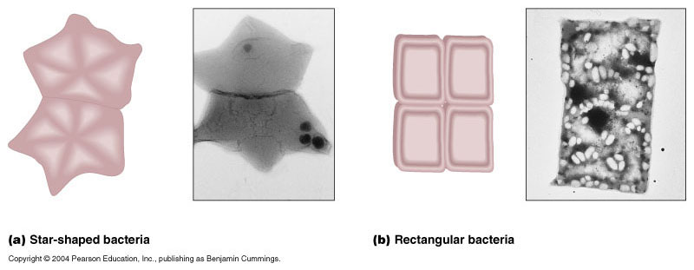
Archae
Prokaryotes
Lack peptidoglycan
Live in extreme environments (extremophiles)
Include:
Methanogens (methane as a metabolic by product
Extreme halophiles (high salt conc)
Extreme thermophiles (high temp)

Slide 22
Fungi
Eukaryotes
Chitin cell walls
Molds and mushrooms are multicellular
Yeasts are unicellular

Slide 23
Algae
Eukaryotes
Cellulose cell walls
Photosynthetic
Produce molecular oxygen and organic compounds
Part of food chain

Slide 24
The size and cell type of microbes
Microbe | Approximate range of sizes | Cell type
Viruses | 0.01-0.25µm | Acellular
Bacteria | 0.1-10µm | Prokaryote
Fungi | 2µm->1m | Eukaryote
Protozoa | 2-1000µm | Eukaryote
Algae | 1µm-several meters | Eukaryote

Slide 25
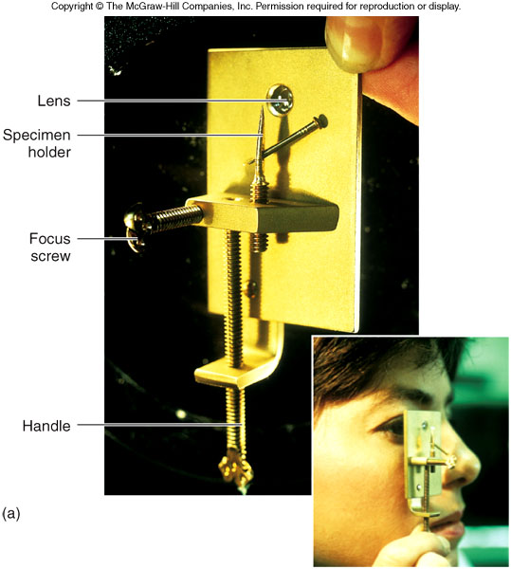
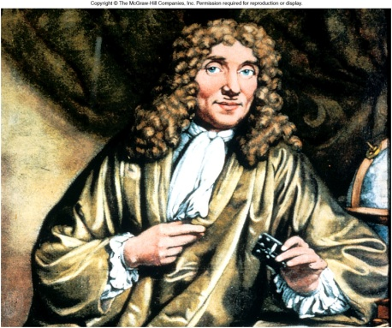
Golden Generation of Microbiology The First Microscope
Microbes were first observed by Antonie van Leeuwenhoek using a simple microscope (ca. 1673)
Reported his “animalcules” to the Royal Society of London

Slide 26
Pioneers in Microbiology drawings of microbes

Slide 27
Spontaneous Generation
illnesses that we now recognize as infectious disease were not linked with microbial life.
Many living things, including microscopic life forms, were thought to arise through Spontaneous Generation (life coming from nonliving matter).
Microbes were finally recognized as being a source of infectious disease, and Germ Theory became more widely accepted,
scientist now needed a method to detect and identify microbial life forms. However, in most cases, microbes are colorless and difficult to see.

Slide 28
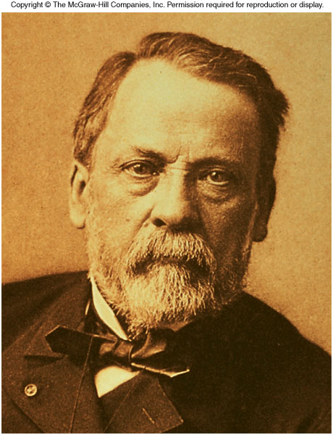
Louis Pasteur
Showed microbes caused fermentation
Studied spoilage and introduced “Pasteurization” to prevent it
Used cotton plugs in his cultures to prevent air borne contamination, devised Aseptic Technique.

Slide 29
Antiseptic and Hand Washing
1860s - Joseph Lister used, carbolic acid, a chemical antiseptic to prevent surgical wound infections
Ignaz Semmelweis, a Hungarian physician introduced hand washing as a means of preventing transfer of puerpueral sepsis in obstetrical patients

Slide 30
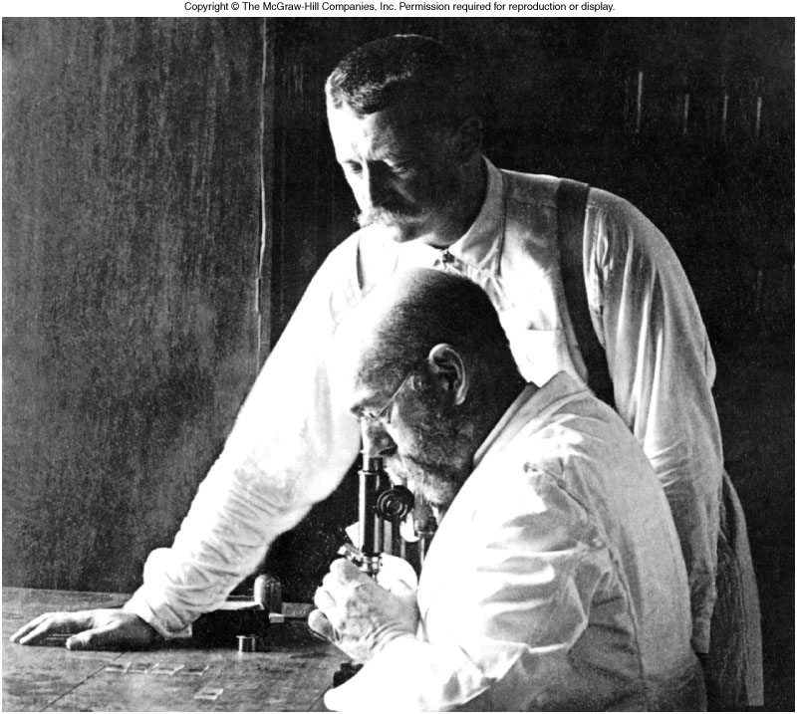
Germ Theory of Disease
1876 - Robert Koch provided proof that a bacterium causes anthrax using experimental steps now called the Koch’s Postulates
He was the first to use agar as solid culture medium in bacteriology.

Slide 31
Koch’s Postulates
The microbe must always be present in every case of the disease
It must be isolated in pure culture on artificial media
When inoculated into healthy animal host it should produce the same disease
It must be isolated from the diseased animal again

Slide 32
Infection and Disease
Infection
Disease
Pathogen
Saprobe
the entry of a microbe into the host.
infection followed by the appearance of signs and symptoms.
an infectious or disease agent.
a microbe that lives on dead or decaying organic matter.

Slide 33
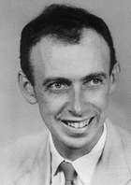
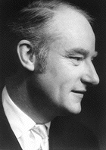
Who Discovered DNA?
DNA was discovered by two scientists working at Cambridge
James Watson and Francis Crick.
1951
Their discovery meant that scientists could understand how parents pass characteristics on to their children—not just their hair and eye colour, but every aspect of their physiology.

Slide 34
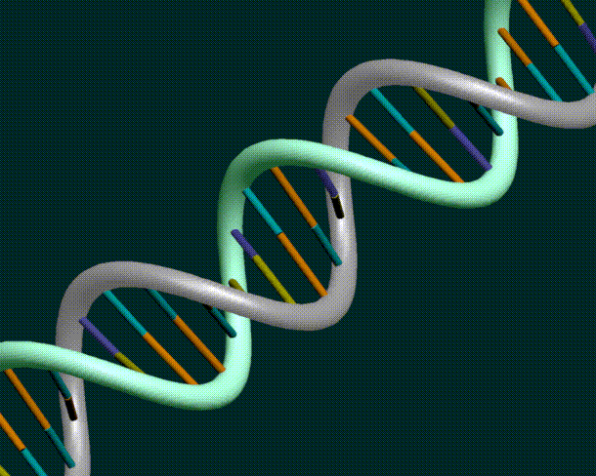
Structure of DNA
-In a DNA molecule, nucleotides exist as two spiral strands linked at their bases (either between A and T or between G and C).
-This structure, which resembles a twisted ladder, is known as a double helix
A
T
C
G

Slide 35
Who Discovered DNA?
Importance of the discovery?
led to practical applications of DNA testing and analysis.
Paternity testing,
forensic DNA evidence, screening for genetic diseases and the development of the biotechnology industry have all been made possible since the discovery of DNA.

Slide 36
Process of DNA fingerprinting
Material DNA extraction
Laboratory tests break down DNA with enzymes
PCR
Enzymatic reaction that multiplies the target DNA into millions of copies
Gel agarose
Apply electricity; labelled pcr products migrate in the agarose
Take a photograph
Process can take 5h

Slide 37
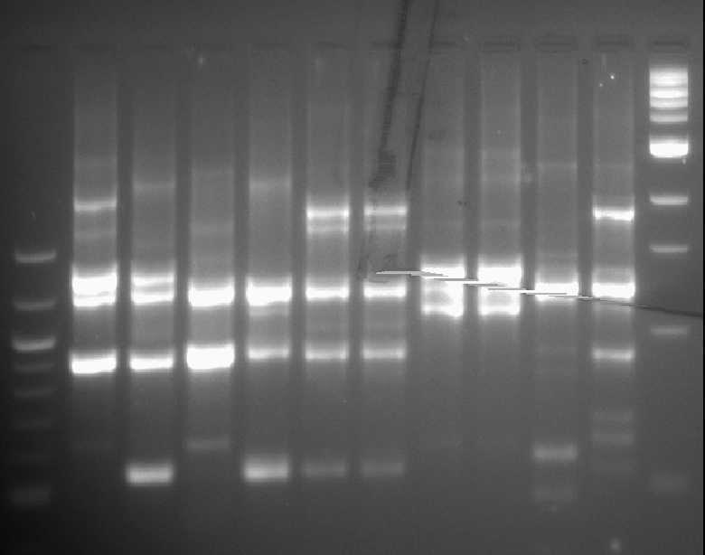
DNA fingerprint
A1
A2
B1
B2
C1
C2

Slide 38
Microbes in our lives
Microorganisms as Disease Agents
Microorganisms and Agriculture
Microorganisms and the Food Industry
Microorganisms, Energy, and the Environment
Microorganisms and the Future

Slide 39
Harmful Effects
Cause disease (basis for bioterrorism)
Food spoilage

Slide 40

Microbiota and man……………1
Three types of relationship………………
Symbiotic relationship/mutualism
microbe factors
Host factors
Symbiotic relation –beneficial to one and the other is not affected; Mutualism-beneficial to both

Slide 41

Microbiota and man……………2
Two types of relationship………………
Parasitic relationship
Host factors
Microbe factors
Host factors
Microbe factors
parasitic relation –beneficial to parasite and harmful to host

Slide 42
Microbiota and man….
Microbes-normal flora
man
Symbiotic relation
microbe factors
Host factors
Man is unaffected

Slide 43
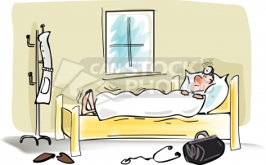
Microbiota and man…..
man
Host factors
microbe factors
Disease
Microbes-normal flora

Slide 44
Microbiota and man…..
Microbes
Normal flora
Imbalances in ecological niche
Symbiotic relation –beneficial to both
Parasitic relationship – beneficial to parasite and harmful to host
Man
Host and microbe factors
Disease
Health

Slide 45
So why study microbiology?

Slide 46
Disease control
Disease
Intervention/prevention
Health
PHO

Slide 47
Disease control
Intervention
Health
Clinical staff

Slide 48
What interventions to cure diseases?
Antibiotics
Surgery
Diet
Physiotherapy
Bed rest

Slide 49
Why Study Microbiology?
The majority of serious diseases in humans (especially those of early childhood) are due to microbial infections
1900, the average life expectancy in the United States was 40 years of age
2000, 80 years, largely due to the near eradication of most serious early childhood diseases
This trend is seen in the gap between developed and developing countries in terms of causes of death (mortality)
Notes:
The large majority of serious diseases in humans (especially those of early childhood) are due to microbial infections. Prior to the discovery of antibiotics and vaccines, a large proportion of children died before adulthood because of infectious disease. In 1900, the average life expectancy in the United States was 40 years of age. That has stretched to almost 80 years in 2000, largely due to the near eradication of most serious early childhood diseases. This trend is seen in the gap between developed and developing countries in terms of causes of death (mortality)

Slide 50
Effects
Basic medical care, antibiotics, childhood vaccination, and increased sanitation
Infectious disease causes a very low proportion of deaths in developed (high technology) countries, while it is the major cause of deaths in developing (low technology) countries
In developed countries, the causes of death are primarily those associated with longer life (cancer, cardiovascular disease) and accidents/stupidity (miscellaneous).
In developing countries, people typically do not survive infectious or parasitic disease long enough to develop these diseases associated with advanced age.

Slide 51



Slide 52
Assignment:
Write an account of the importance of micro-organisms to humankind.

